Slide 1
The “Magic” of Machine Learning through Genetic Algorithms

Slide 3
What will you get out of this talk?
Understanding of the fundamentals of Genetic Algorithms
Generations
Fitness
Populations
Solutions

Slide 4
The Knapsack Problem

Slide 5
The Knapsack Problem
I’m going on a camping trip and have a list of items, each with a weight and priority, that I would like to take with me but I’ve only got room in by backpack for 100 lbs of things.
What can I take with me?

Slide 6
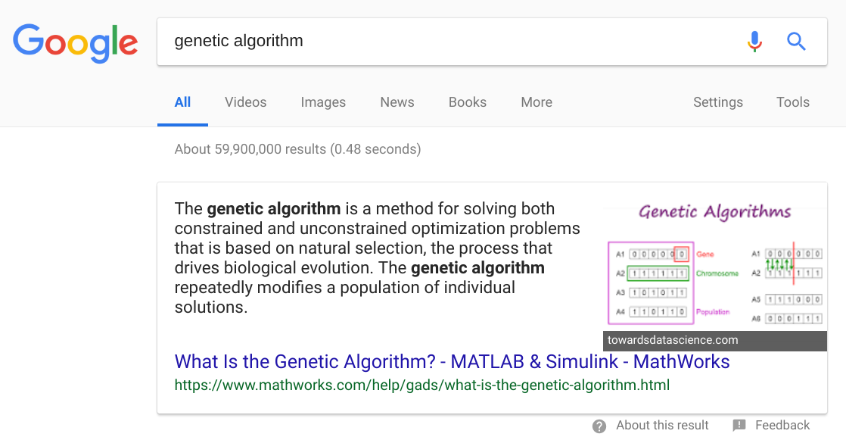
What is a Genetic Algorithm?

Slide 7
Softball #1
1

Slide 8
Softball #2
0

Slide 9
Softball #3
[0,1,1,0,1]

Slide 10
What is a solution?

Slide 11
What is a solution?
A bit array [1,0,0,1,0,1,1,1,0,1,0,0]
Represents a possible solution to a problem.
Can indicate raw data or multiple Boolean values.

Slide 12
Solution
[0,0,0,0,0]
[0,1]
[1,1,0,0,1,0,1,1,1,1]
[1,1,0,0]
[.25, .17, .87, .90, .00]

Slide 13
Generation Cycle

Slide 14
Generation Cycle
Select Parents
Generate a population
Interpret and Test Fitness

Slide 15
Generate a Population

Slide 16
Initial Generation
Generate a random population of solutions.

Slide 17
Interpret and Test Fitness

Slide 18
Interpretation
A problem specific function that translates a solution into something that is workable is typically needed.

Slide 19
Interpretation Knapsack Example
Given 10 possible items that could be in a backpack.
Each item is either in or out of the backpack.
Our bit array represents multiple true/false values.
[1,1,0,1,0,0,0,1,1,0]

Slide 20
Fitness
The numeric representation of how close a specific solution is to solving the given problem.
Fitness functions are specific to the problem you’re trying to solve.
A fitness function will evaluate the solution and return a number.
The higher the number the more “fit” a solution is.

Slide 21
Fitness Example
function findFitness(solution) { var fitness = 0, i = 0, desiredBits = 2; for (var i = 0; i < solution.length; i++) { fitness += solution[i]; } return { value: 1 / Math.abs(fitness - desiredBits), perfect: (fitness == desiredBits) }; }

Slide 22
Select Parents

Slide 23
Select Parents
Find the top solutions based on fitness score.
Typically a higher fitness only provides a greater chance to be selected not a guarantee.

Slide 24
Generate a Population

Slide 25
Generate a Population
Take the top selected parents and mate them to create a new population.
Not constrained by traditional biological boundaries.

Slide 26
Generation Crossover
Split both parents near the middle to mate them.
[?,?,?,?,?,?,?,?] and [?,?,?,?,?,?,?,?]
[?,?,?,?,?,?,?,?]
[?,?,?,?,?,?,?,?]
[?,?,?,?,?,?,?,?]
[?,?,?,?,?,?,?,?]
etc.

Slide 27
Generation Mutation
After mating, each bit has a small random chance to be flipped.
The chance of mutation is called the mutation rate and it is typically around 1%.
[0,0,0,0,0,0,0,0]
[0,0,1,0,0,0,0,0]
[0,0,0,0,0,0,1,0]
[1,0,0,0,0,0,0,0]
[0,0,0,1,0,1,0,0]
etc.

Slide 28
Termination Conditions

Slide 29
Termination Conditions
A termination condition tells our algorithm when to stop creating more generations.
There are three common ones:
Time
Generation Count
Fitness Threshold

Slide 30
Termination - Time
Stops processing after a certain interval of time has passed.
“Only create new solutions and generations for 3 minutes then stop.”

Slide 31
Termination - Generation Count
Stop looking for new solutions after you have reached a certain number of generations.
“Only create 1000 generations and then return the best solution found during that time.”

Slide 32
Termination - Fitness Threshold
When an ideal fitness score is known then it is good practice to stop processing once that threshold is found.
“A perfect fitness score is 1.0, if you find a solution with that fitness stop processing and return the solution with the 1.0 fitness score.”

Slide 33
Demos

Slide 34
Code
Raw bit count
Knapsack Problem
JavaScript function generator

Slide 35
Summary
Genetic Algorithms solve a problem.
A solution is one possible way to solve the problem.
A generation is a series of solutions from the same parents.
Problem Specific
Fitness Function
Interpretation Function
Termination Conditions indicate when to stop processing.
Generational Cycle
Generate Population
Test Fitness
Find Parents

